Slide 1
Ducky Gauntlet Concept Art
Devin Fitzgerald, Samwise Majchrzak, Heather Miller

Slide 2
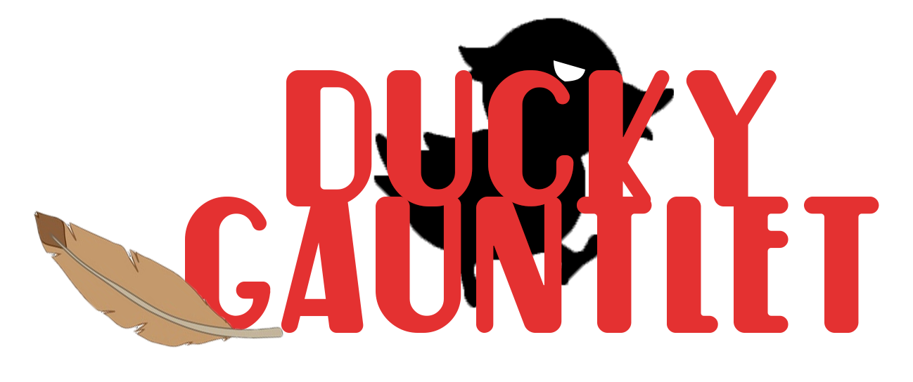
Logo- Devin Fitzgerald

Slide 3
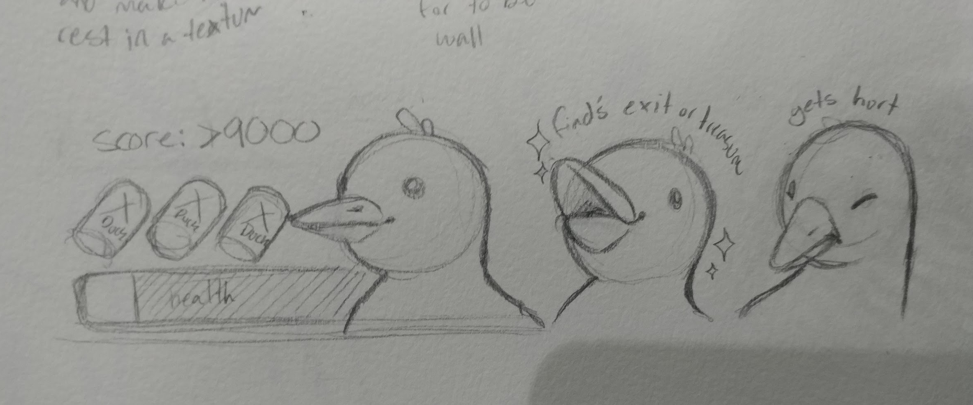
UI Concept Art- Sam Majchrzak

Slide 4
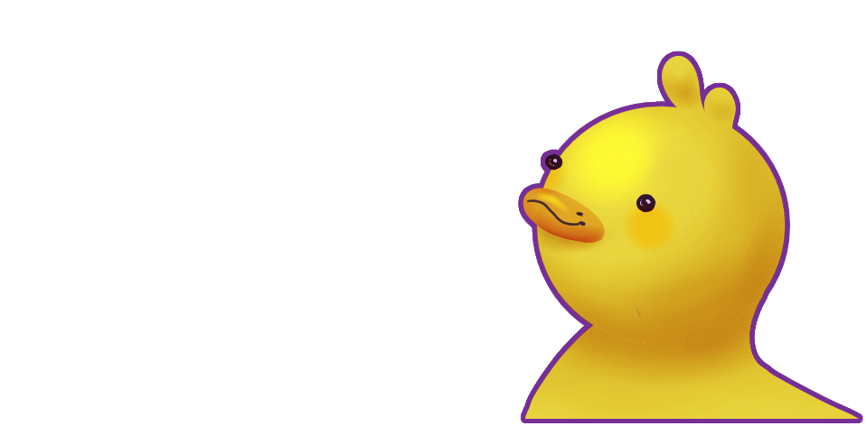
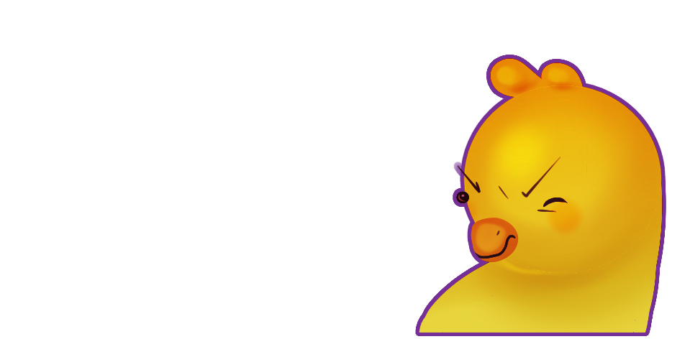

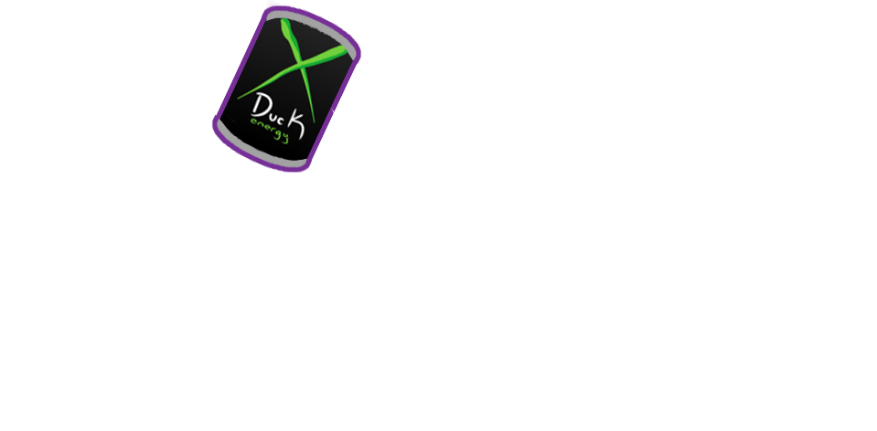
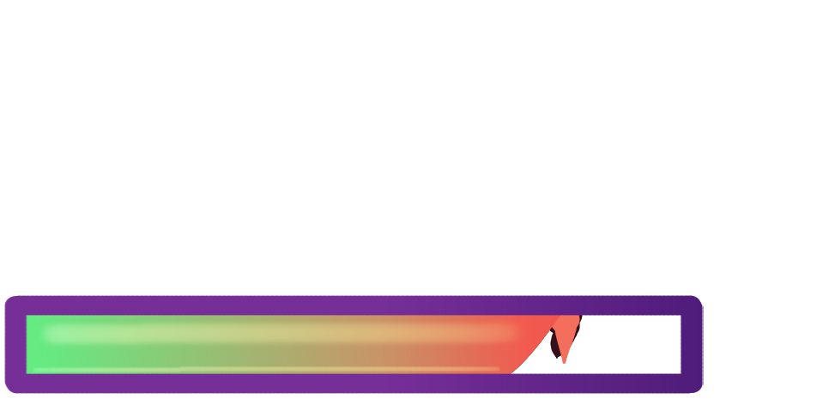
UI- Sam M.

Slide 5
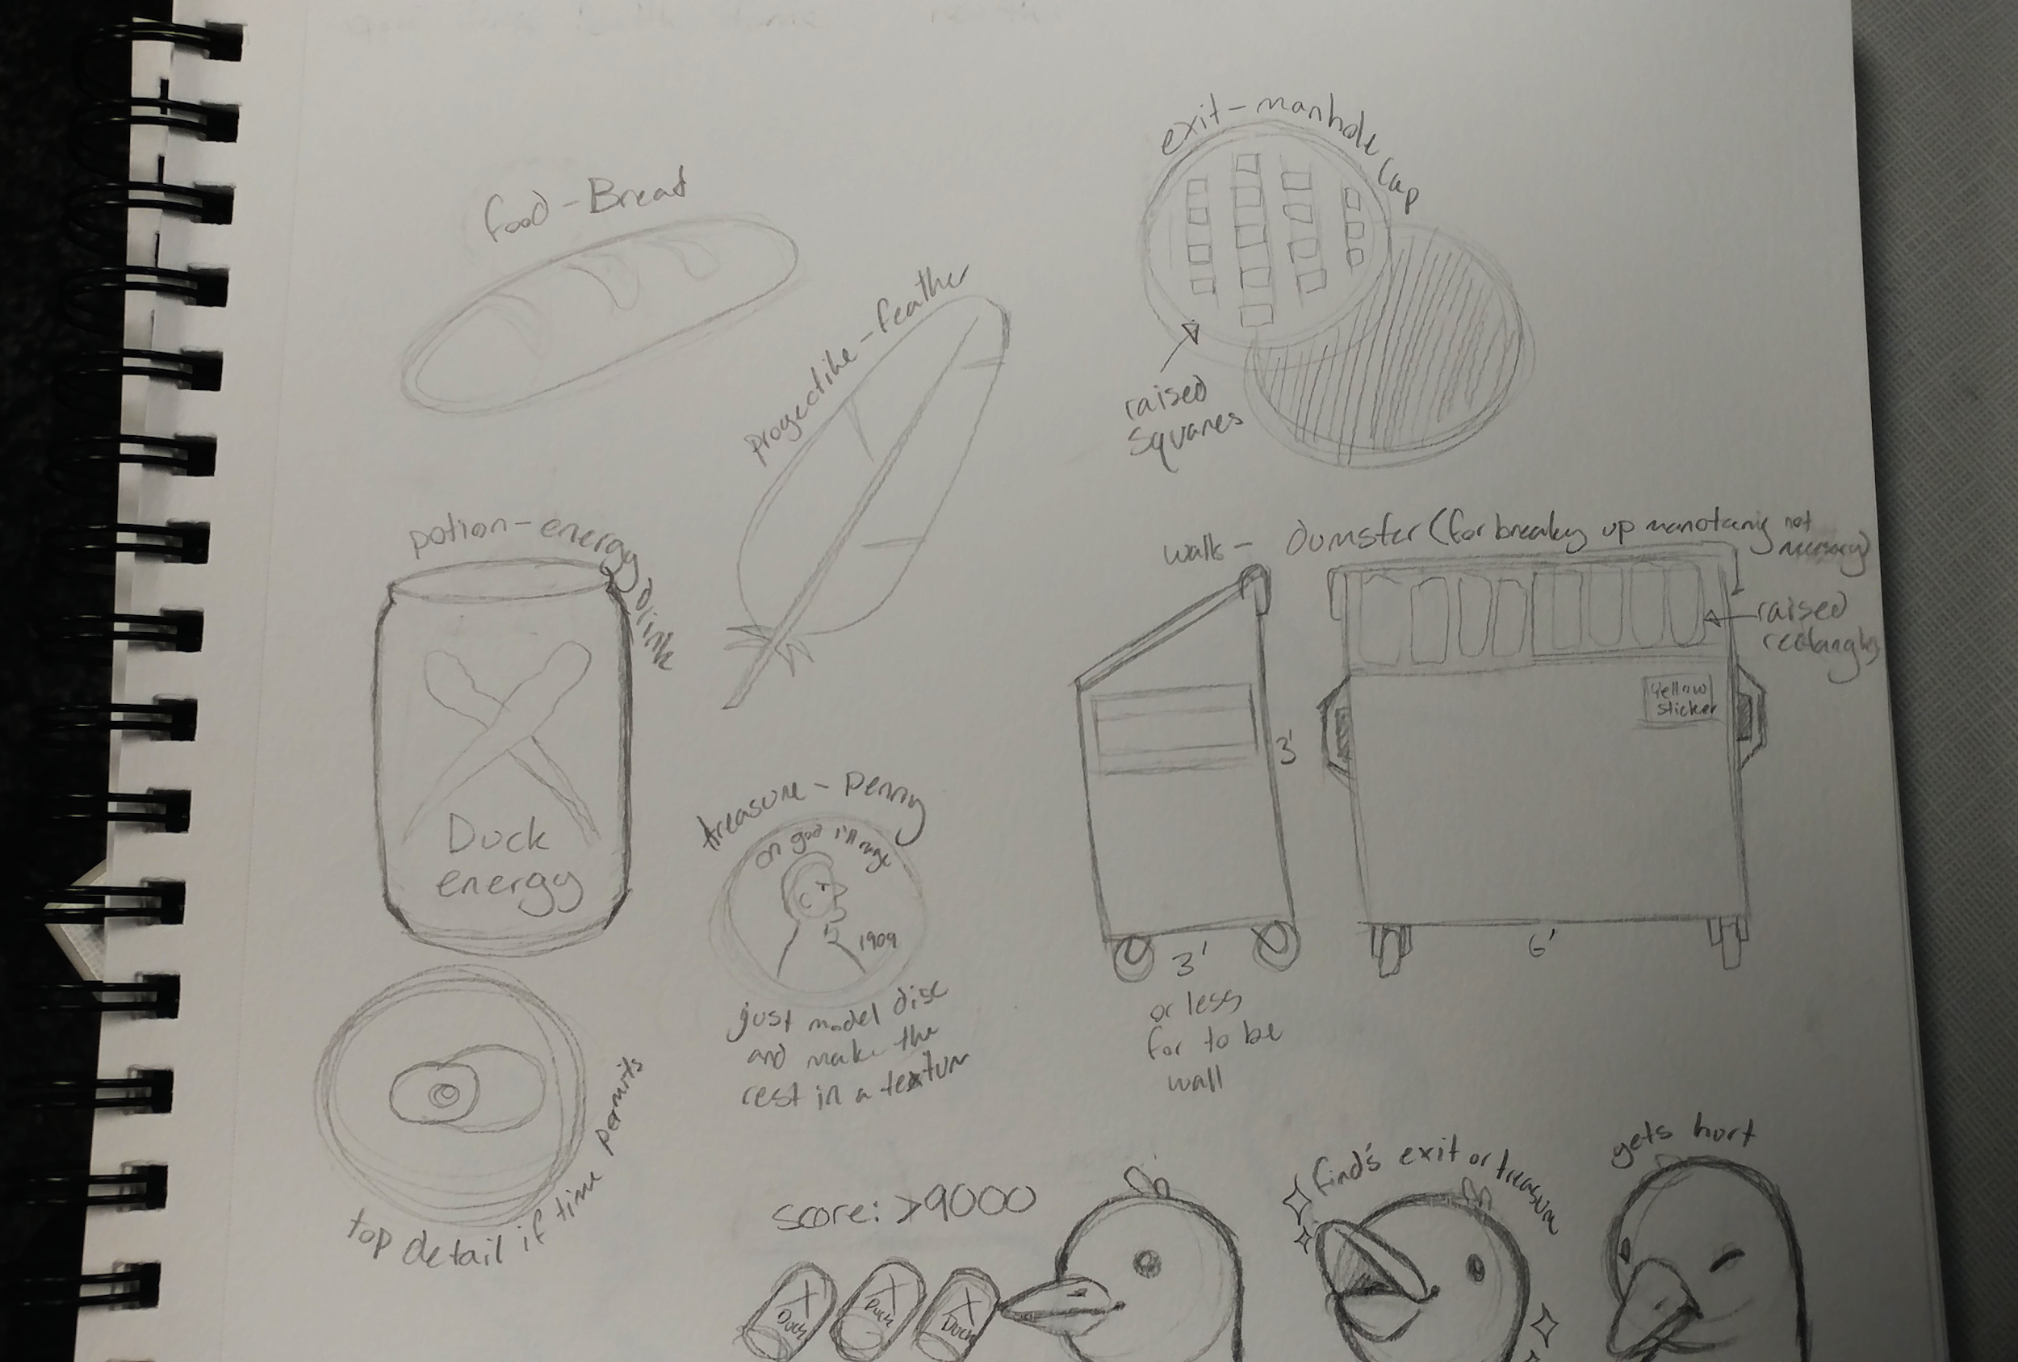
Prop Concepts- Sam M.

Slide 6
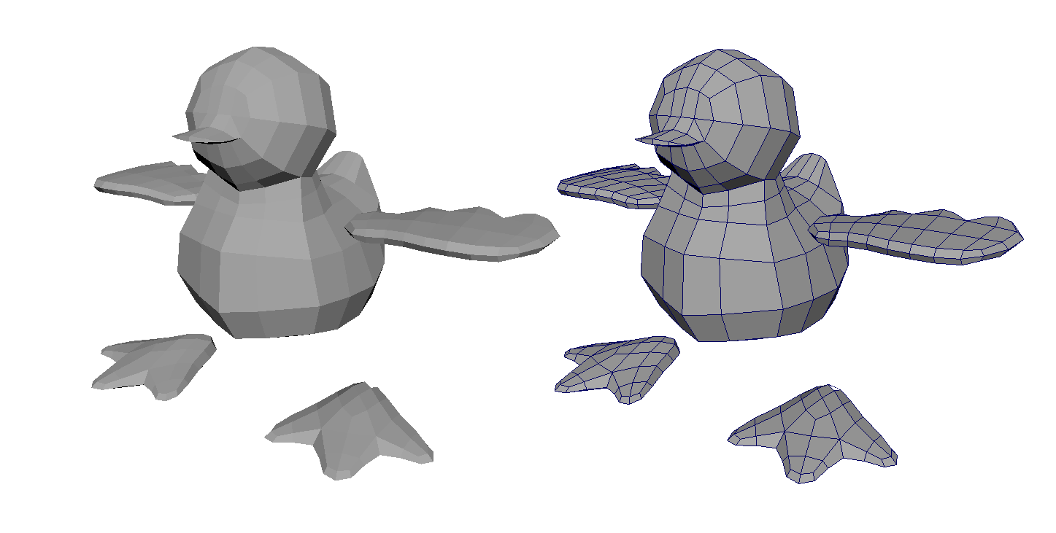
Duck Model- Heather Miller

Slide 7
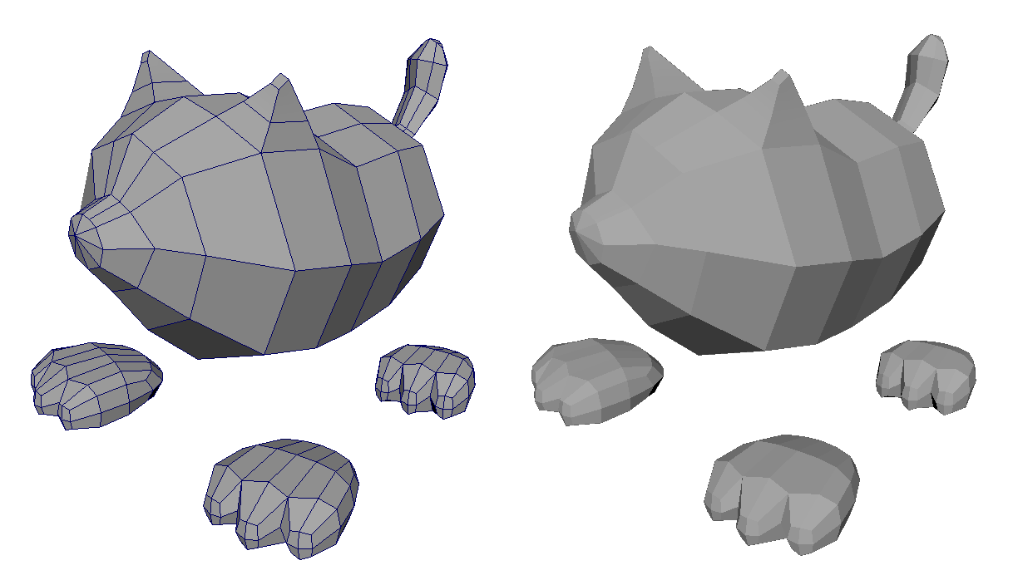
Cat Model- Heather Miller

